Slide 1



Brick breaker game
A 2D GAME USING PYTHON
NAME :Kedara Sri Surya Manobhiram Manchimchetti
REGISTRATION NUMBER :12305323
ROLL NUMBER :RK23CHA32
SECTION :K23CH
BRANCH :Computer Science Engineering

Slide 2
Table of content :
Serial number
Components
1
2
3
4
5
6
7
8
9
10
Introduction
About the game environment
Design of game board
Implementation of ball mechanics
Detection of collision and scoring
Power ups
Game levels
User interface
Limitations
Conclusion

Slide 3
Introduction to Brick Breaker
This project is a Python-based project or game which is made using pyGames.
Gameplay Overview:
Brick Breaker involves controlling a paddle to bounce a ball against bricks, breaking them, with the goal of clearing all bricks on the screen.
Key Elements:
The game features a paddle, ball, bricks, scorekeeping, power-ups, and level progression.

Slide 4

About The Game Environment:
1. )Libraries: Start with the Pygame library for graphics. A standard Python library used for generating random number.
2.)Game guide:
Objective: Break all the bricks with the ball and paddle.
Avoid missing the ball to stay alive.
Increase your score by breaking bricks and completing levels.

Slide 5


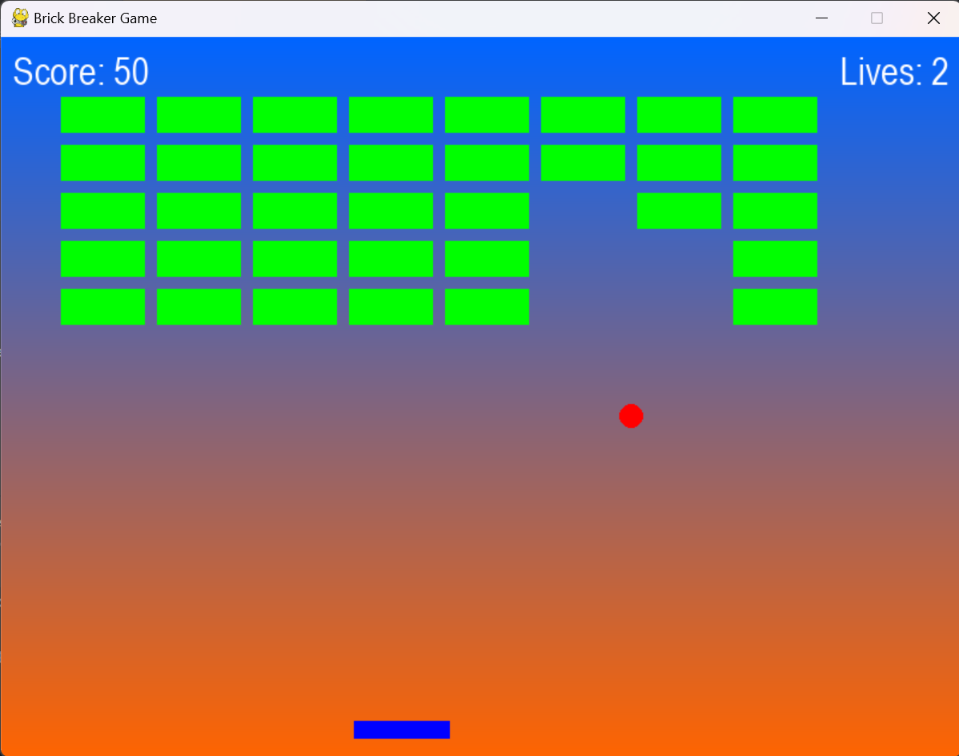
Designing The Game board:
1.) Screen Dimensions :
Width: 800 pixels
Height: 600 pixels
2.) Bricks :
Created grid of bricks with green colour and different properties.
3.) Paddle :
The paddle is placed at the bottom of the screen to bounce the ball and break the bricks.
4.) Ball :
The ball which is present in the game always keeps bouncing and have 3 lifes.

Slide 6
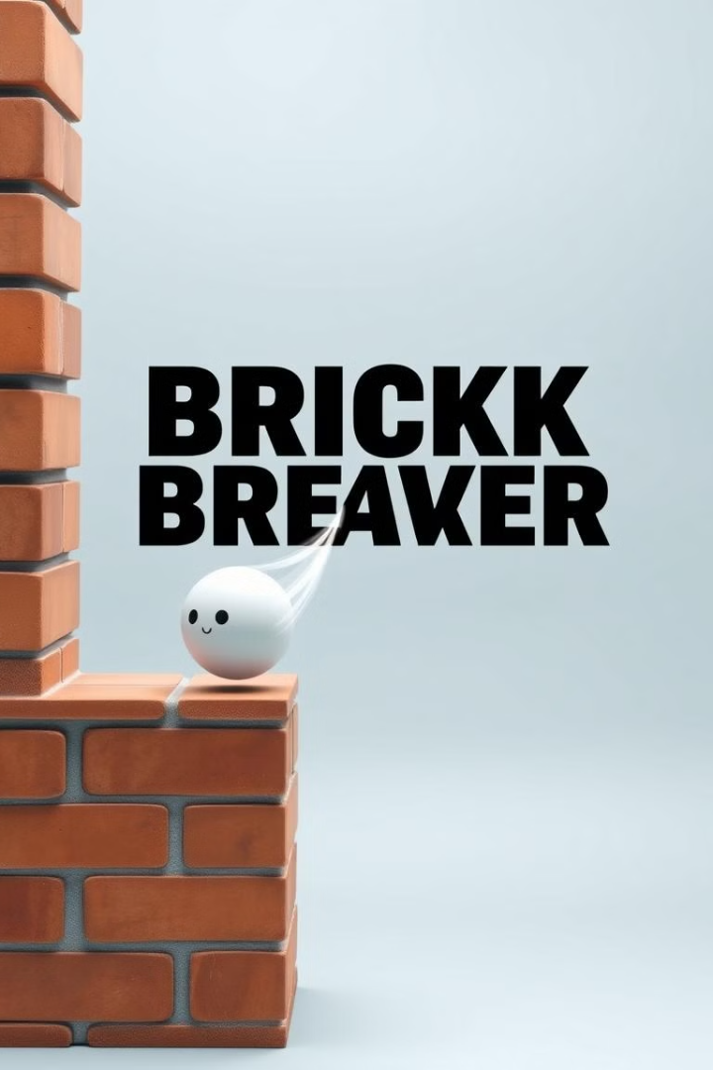

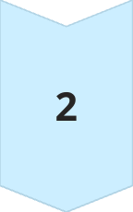
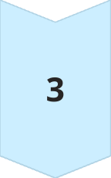
Implementing The Ball Mechanics :
Ball Movement :
Set the initial ball speed and direction, updating its position with each frame.
Bouncing of Walls :
Reverse the ball's direction when it collides with the top, left, or right walls.
Collision Detection :
Determining if the ball collides with bricks or the paddle.

Slide 7



Detecting Collisions and Scoring:
Ball-Brick Collision
1
Checking if the ball's position intersects a brick.
2
Brick Removal
Remove the brick and update the score when a collision occurs.
3
Ball-Paddle Collision
Changing the ball's direction when it hits the paddle.

Slide 8
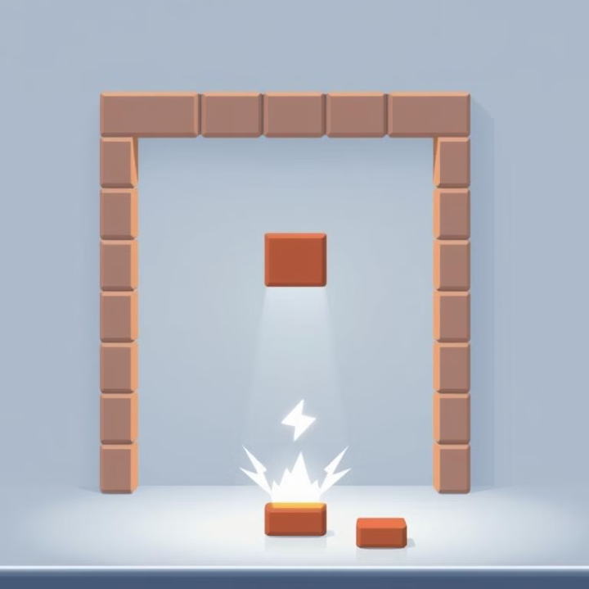
Introducing Power-ups and Obstacles:
1.) Power ups : We can power It by changing the peddle size and change speed of the ball.
2.) Obstacle Design : Introduce obstacles that block the ball's path or change its trajectory.
3.) Power-up effects : Implement the effects of power-ups on gameplay, such as. The game starts with 3 lives, and the player loses a life each time the ball falls below the paddle; the game ends when all lives are lost.

Slide 9
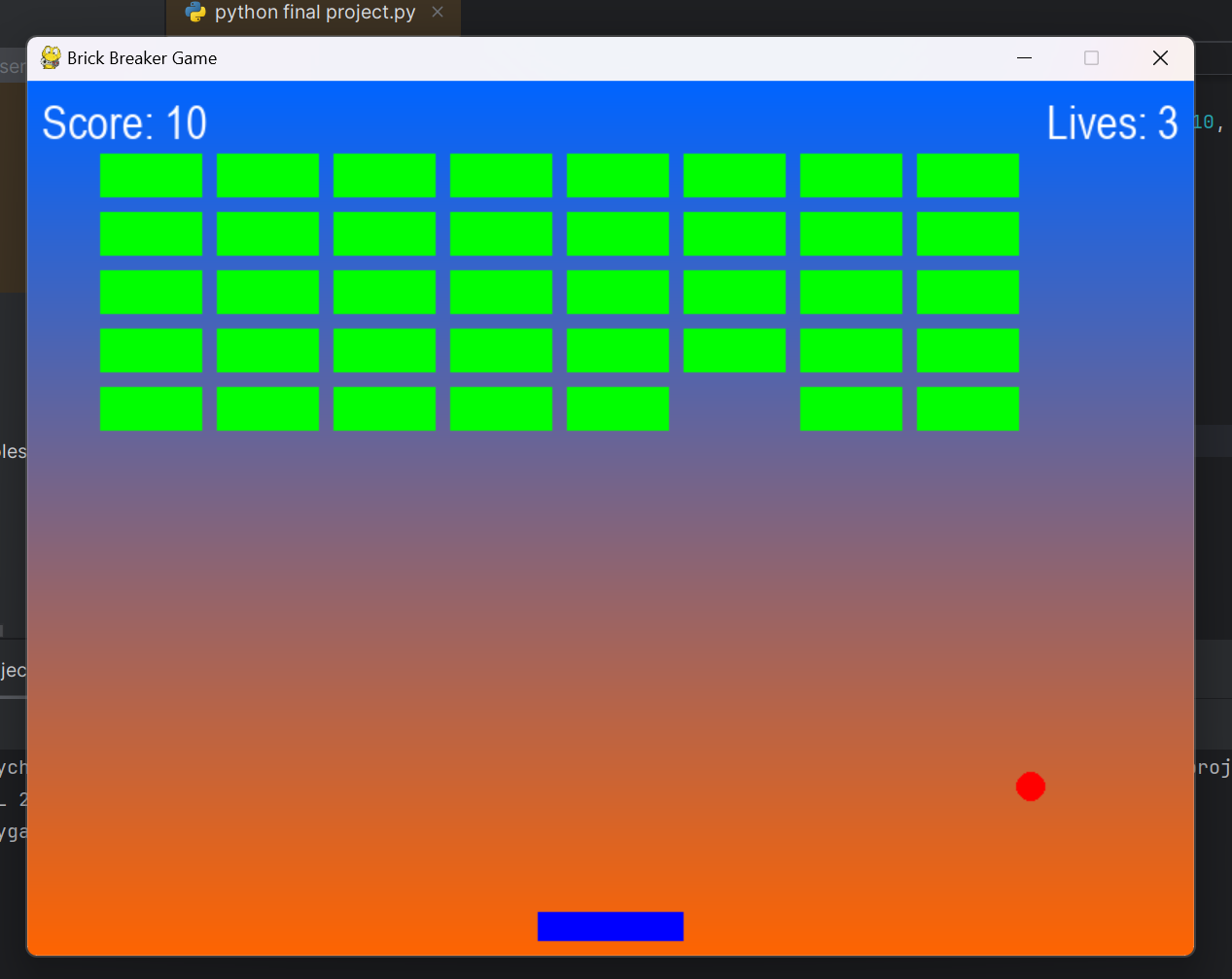
Implementing Game levels and Progression :
Scoring : The score increases by 10 points each time the ball collides with and destroys a brick.
Level Progression : Increase ball speed or brick strength with each level.
Challenge Variations: Introduction of new obstacles, power-ups, or game mechanics as players advance.

Slide 10
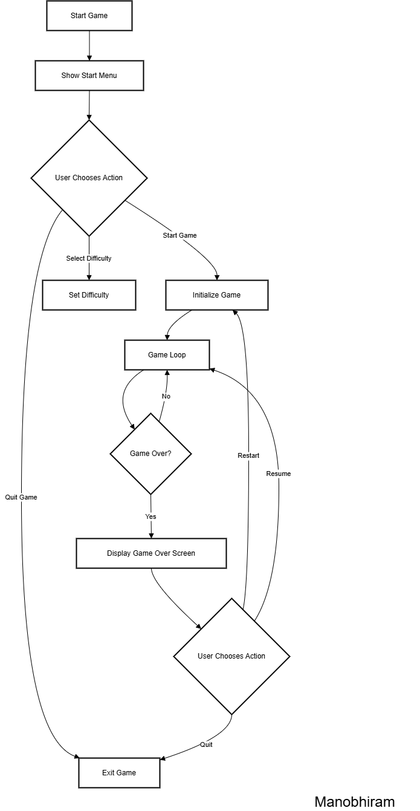
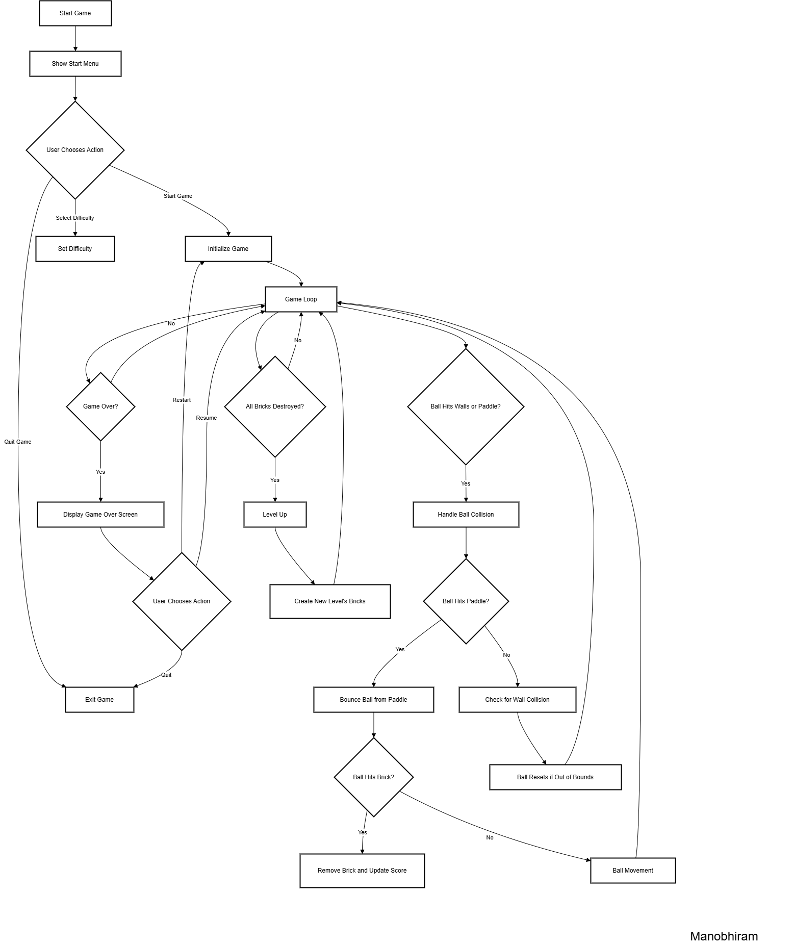
DFD:
Level 0
Level 1

Slide 11
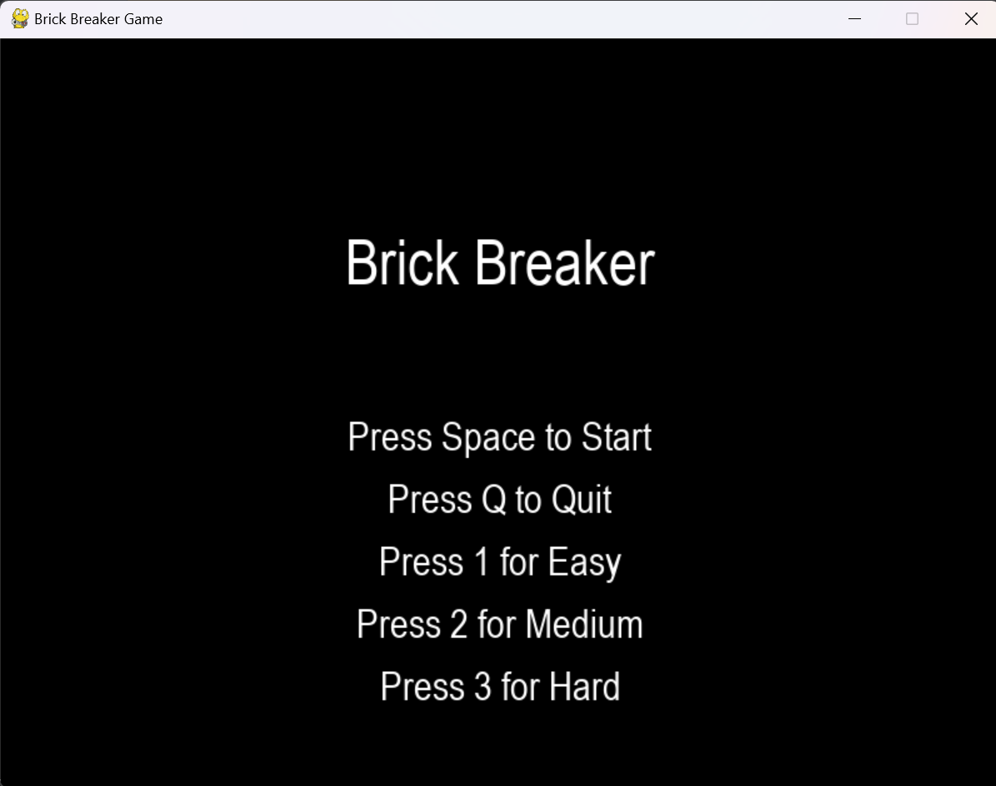
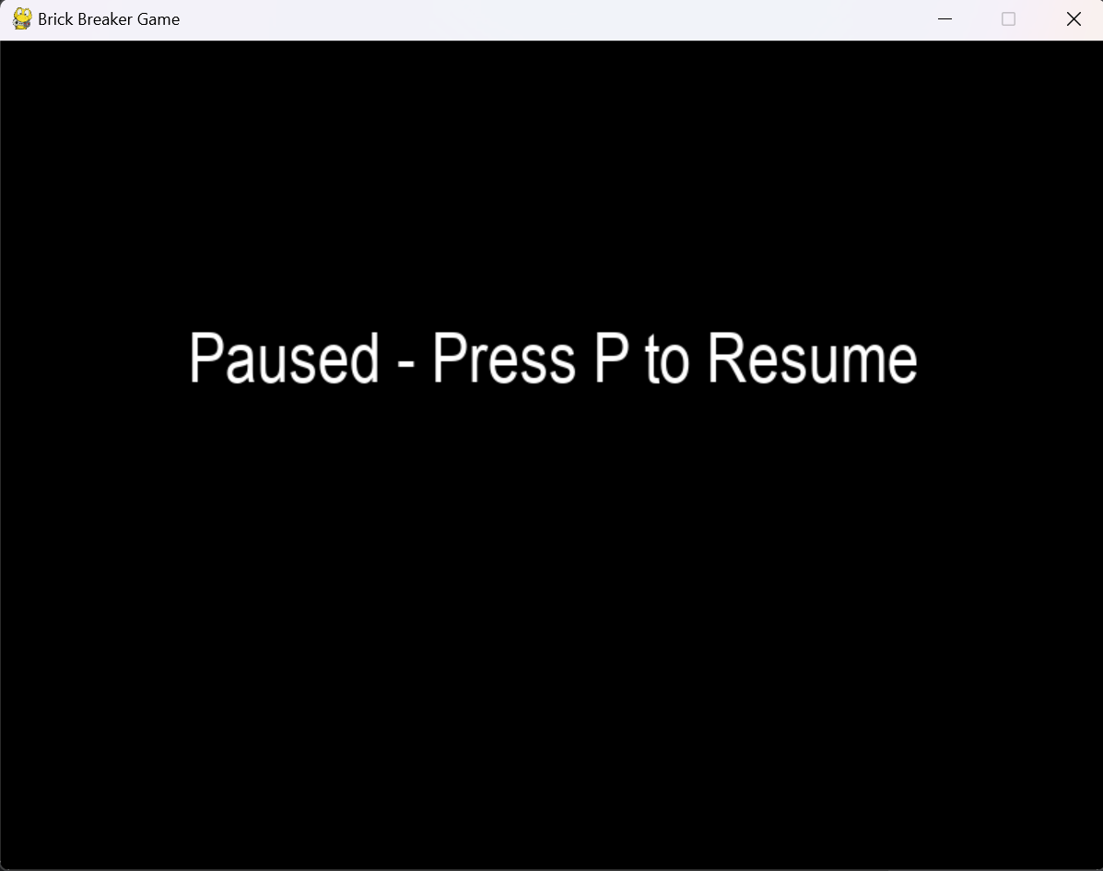
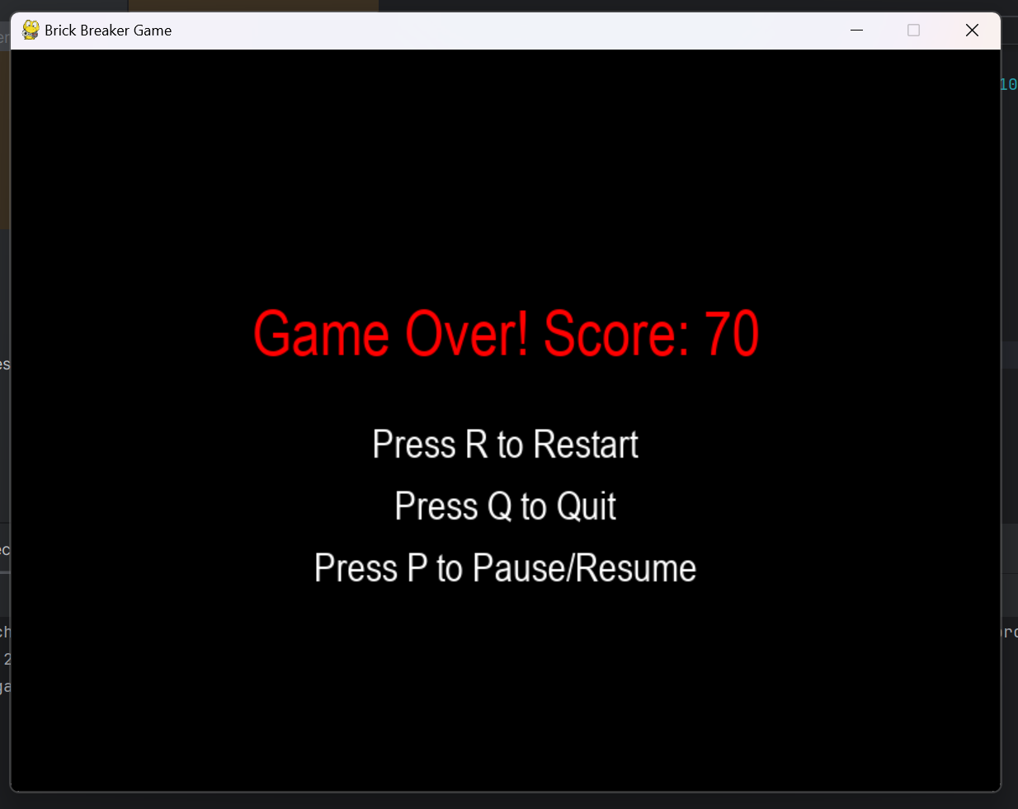
Developing a polished user Interface :
Menu Screen : Home Screen for start ,quit and for the level of difficulty in the game.
Pause option:The pause feature in the code allows players to temporarily stop the game by pressing the P key.
Game over Screen: Displays score and a total of 2 buttons to exit the game or restart it.

Slide 12
Limitations:
Limited Control :
Unpredictable Bounces :
The collision angle adjustment based on the distance from the paddle center is simplistic and could lead to unexpected ball trajectories.
Uncontrolled angles lead to erratic ball movement, hindering player strategy and making the game more frustrating.
Gameplay Challenges
Limited angle adjustments can create gameplay scenarios where a player has little control over the ball's path.

Slide 13

No sound effects :
Immersion
Sound effects enhance the game's immersion by providing auditory cues for actions and events.
Feedback
Audio feedback reinforces actions, like ball collisions and brick destruction, making the game more engaging.
Atmosphere
Sound effects contribute to the game's overall atmosphere, adding excitement and depth to the gameplay experience.

Slide 14

Conclusion:
The Brick Breaker game project, developed using Python
and the Pygame library, successfully achieved its primary
objectives of creating an engaging and interactive game.
The project provided a comprehensive learning experience,
covering essential aspects of game development such as event
handling, collision detection, and game state management.

